Slide 1
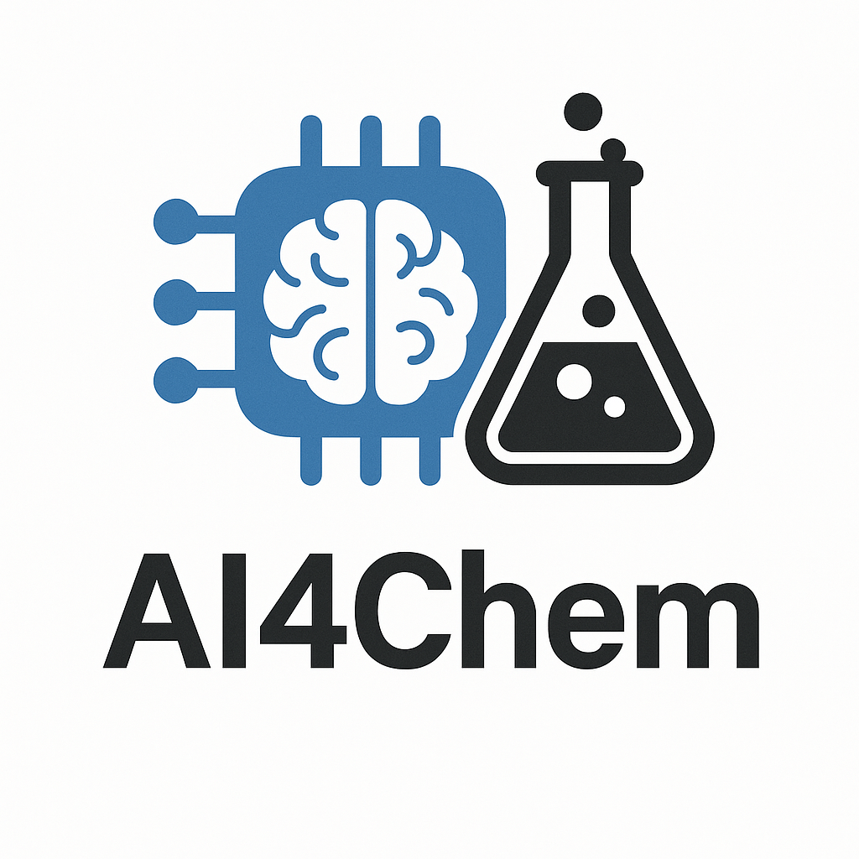
CHEM 799 pip install chemistry
Rodrigo A. Vargas Hernández
vargashr@mcmaster.ca

Slide 2
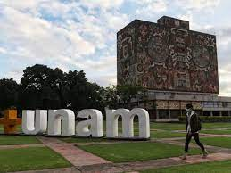
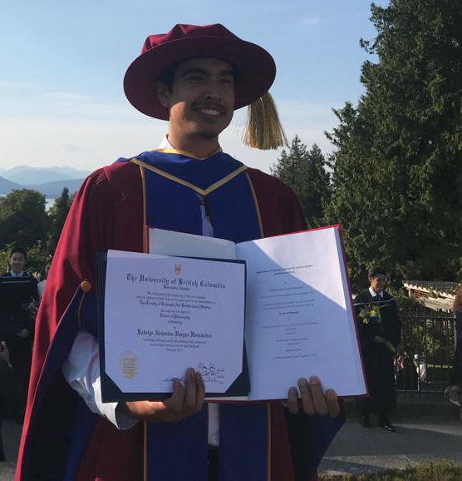
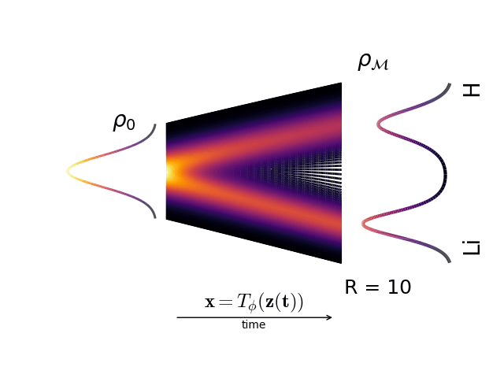
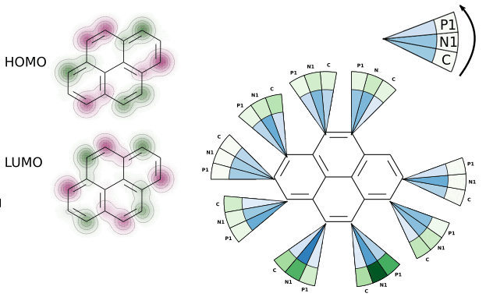
Who am I?
Born in Mexico city
Undergraduate: UNAM
comp. chemistry
PhD: UBC Vancouver, BC
ML/AI for Chemistry
Postdocs: UofT
more ML/AI and Chemistry
Hobbies: cycling and coffee
not me
ChemAI group
more** ML/AI and Chemistry/Physics
new comp. tools for simulating chemistry

Slide 3
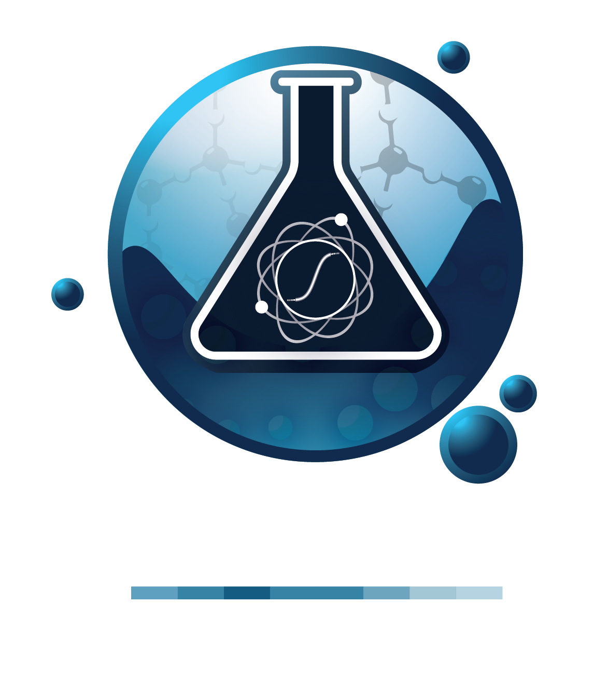

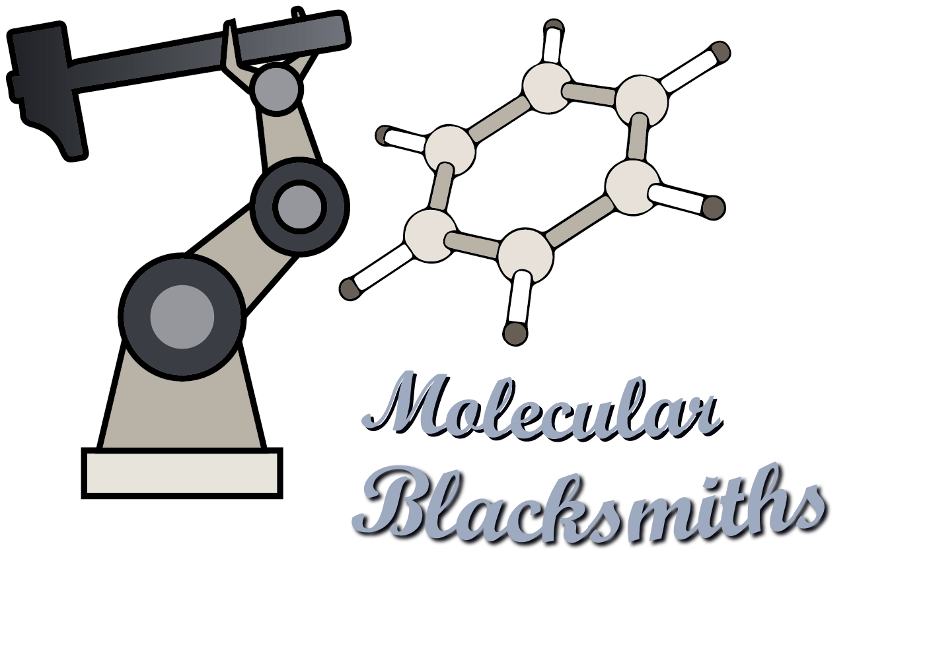
GenAI for Quantum Science
AI for Materials
How much can ML models learn?
Can we improve physical models?
Do pre-trained ML models work?

Slide 4
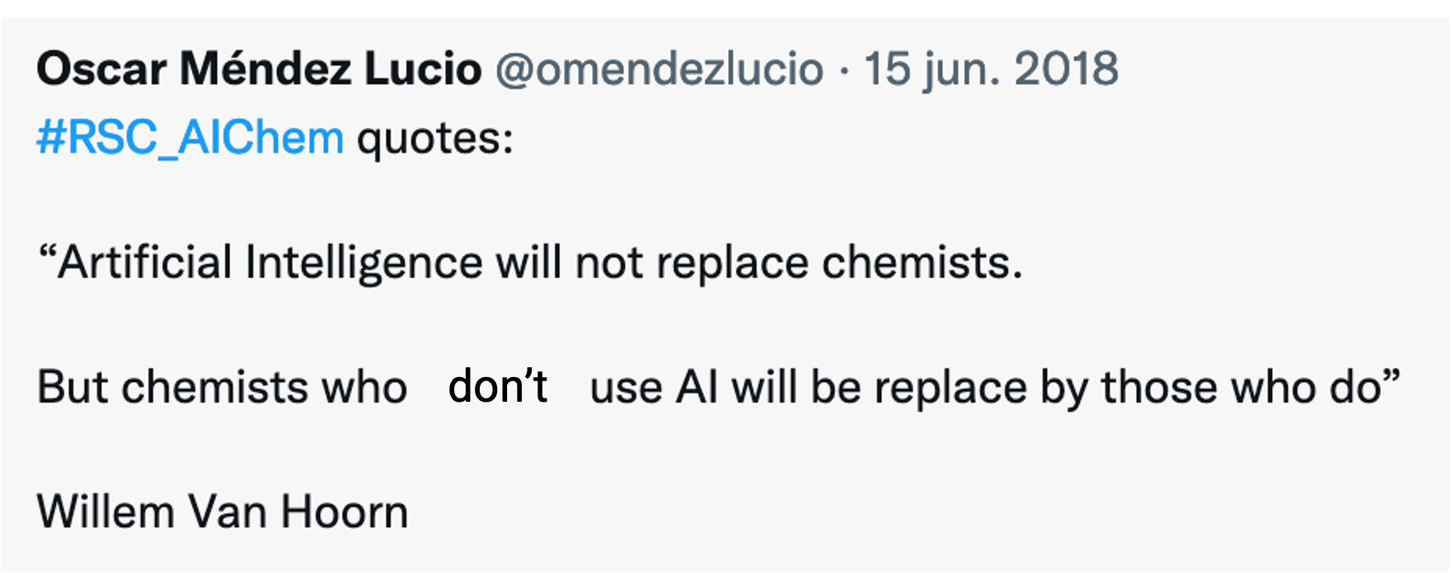
Goal
Do NOT be afraid of coding!
coding
new tools

Slide 5
Evaluation
Course component | Marks |  | Notes
Final project Deadline: March 15th | Oral presentation | 30% | 25 min: 15 + 5 + 5
 | Code | 40% | Code (Google Colab)
 | Written report | 30% | Maximum 4 pages, without refs. single column
 | Total | 10%
There is no homework and midterm so there isn’t an
excuse for not spending time on your final project

Slide 6
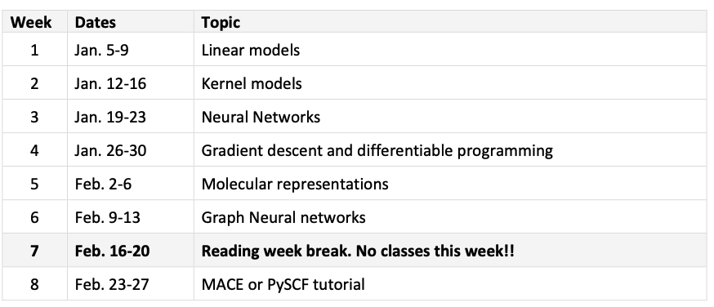
Outline
*the depth will depend on how we advance in the course

Slide 7
References
This course does not follow a specific book as it designed to be a collection of topics that are relevant for a common undergraduate program in chemistry. However, if the student wants to consult here are some recommended books:
Pattern Recognition and Machine Learning, C. M. Bishop.
Probabilistic Machine Learning: An Introduction, K. P. Murphy.
Deep Learning for Molecules & Materials, A. D. White.
The internet!!

Slide 8
Final Project (Almost like a quality paper)
Examples:
Published paper: Reproduce part of a work.
Model(s) fitting on your own data.
Statistical analysis.

Slide 9
Final Report (Deadline: March 15th)
Section I: Introduction, literature review and problem statement (0.5 pages)
Section II: Methodology (1 page)
Section III: Describe the model/data or chemical system (1 page)
Section IV: Results (1 pages)
Section V: Summary (0.5 page)
Section V: Future work (0.5 pages)
Section VIII: References (not included in the page limit)

Slide 10
Final Presentation
Time limit:
Total 25 minutes:
15-20 min: present your work
5-7 min: go-through a working demo using your (part) code
5 min: questions (part of your mark!)
Colab demo:
Google Colab demo that was used in your final project
(example) https://github.com/RodrigoAVargasHdz/steady_state_jax

Slide 11
Academic Integrity in the era of Generative AI
Academic Integrity in the era of Generative AI
As a researcher in the field of machine learning and AI, I recognize the significant potential of these modern tools to enhance the learning process. I support their responsible use, with the understanding that the author who submits the work is ultimately accountable for its content and any potential repercussions.
In this course, where the primary objective is to develop students' mathematical and coding skills, it is essential to ensure that all work reflects genuine analysis and understanding.
The instructor and TA will be vigilant in identifying any instances of "copy-paste" answers, particularly those that appear to be generated by AI without sufficient student comprehension. If the instructor or TA suspects that an answer has been directly copied from a chatbot, the student will be required to explain their reasoning. Responses such as "this is what ChatGPT told me" will not be tolerated. Based on the explanation provided, appropriate consequences may be determined.
Use these amazing tools but do not take them for granted

Slide 12
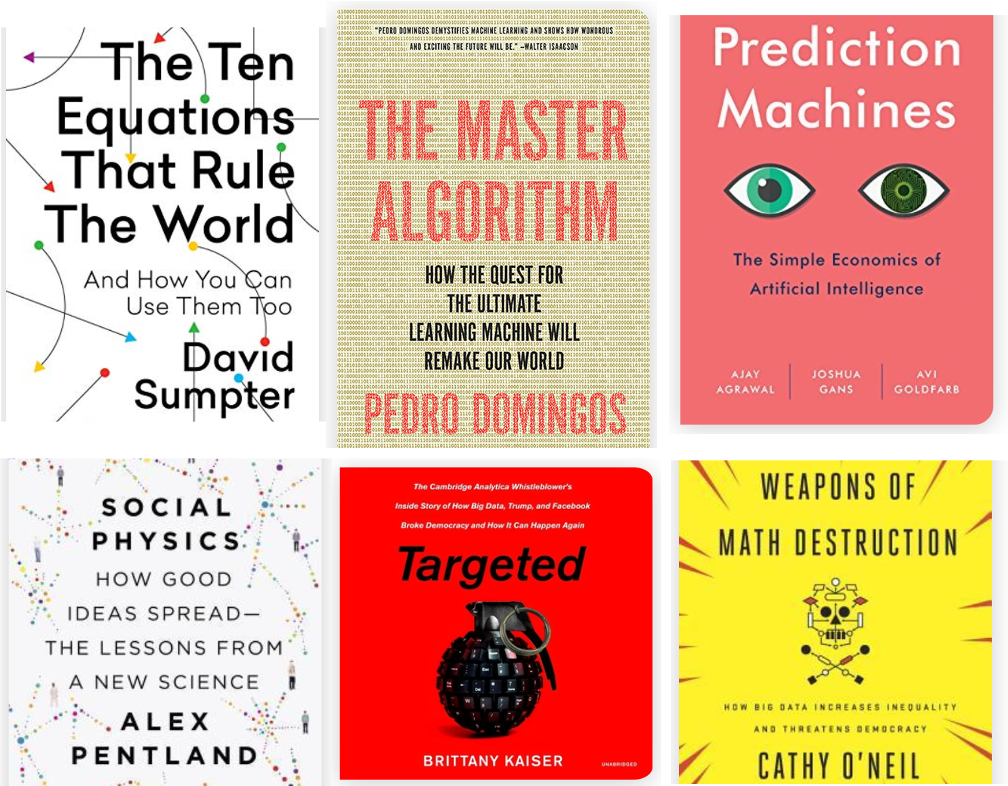
Why should Chemist develop some Math and Programming skills?
Why should Chemist develop some Math and Programming skills?

Slide 13
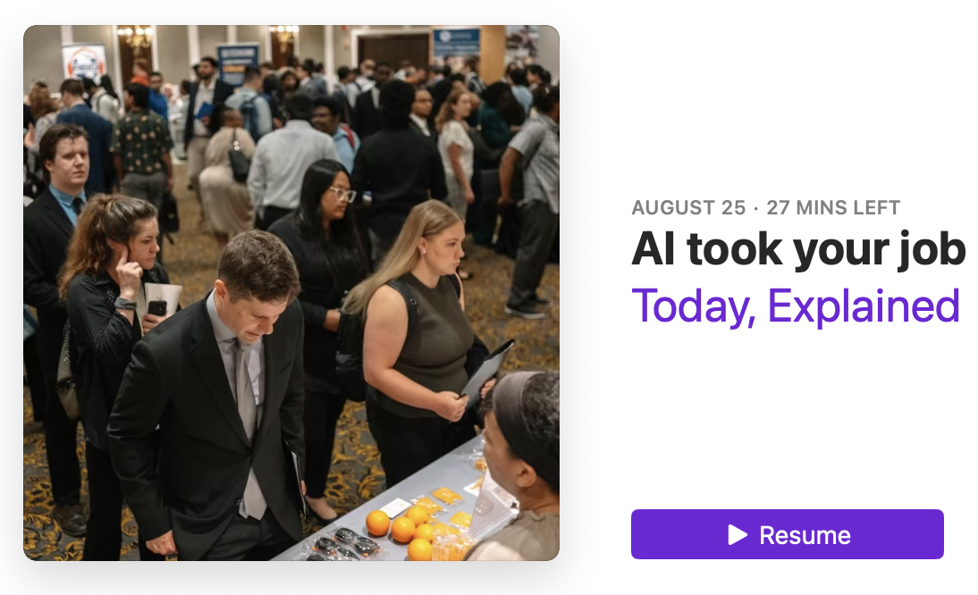
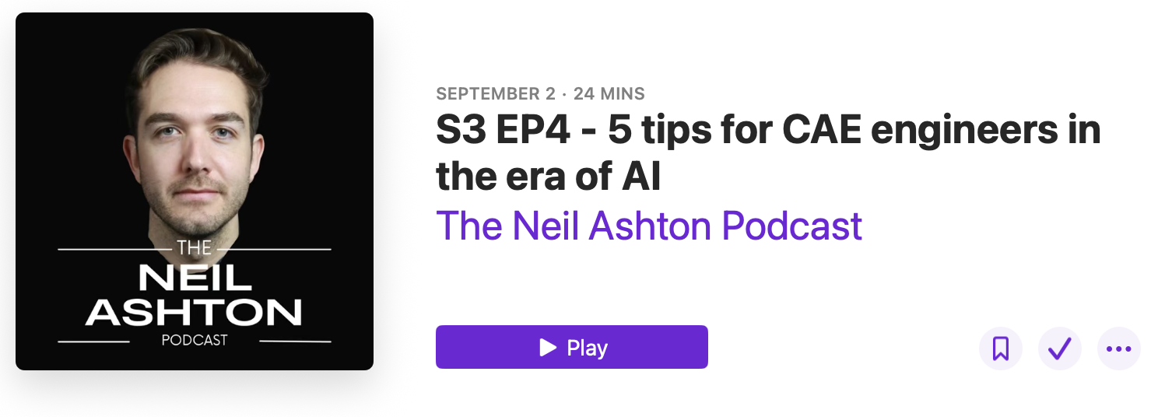
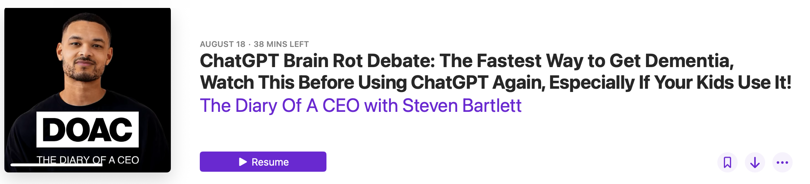
Students in the era of AI-Agents

Slide 14
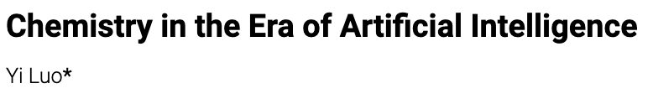
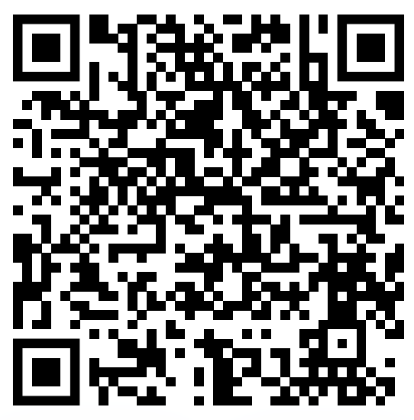
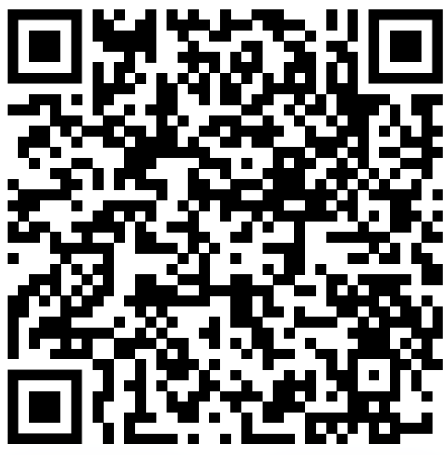
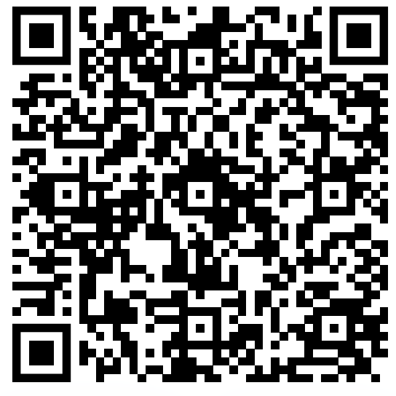
Questions about ML/AI?
How AI is Changing Chemical Discovery? Victor Hugo Cano Gil

Slide 15
What do you want to learn?
This course is for you!

Slide 16
References
Use the internet!

